Slide 1
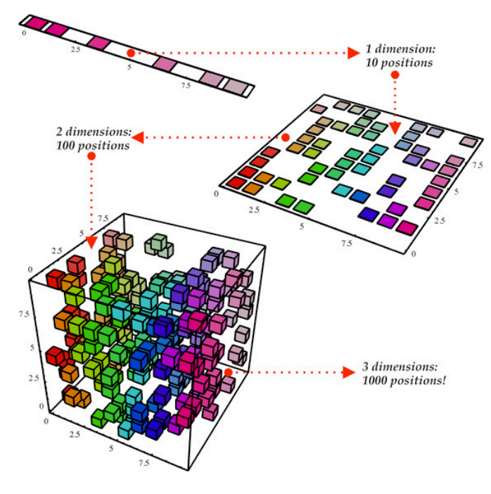
SVD and PCA

Slide 2

Outline
Singular Value Decomposition(SVD)
Principal Component Analisys(PCA)
Learning Linear Transformations

Slide 3
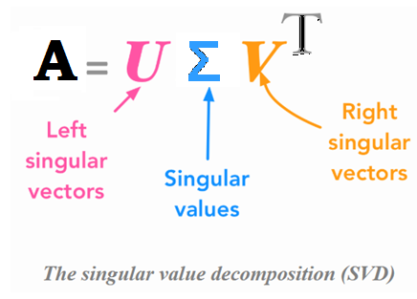
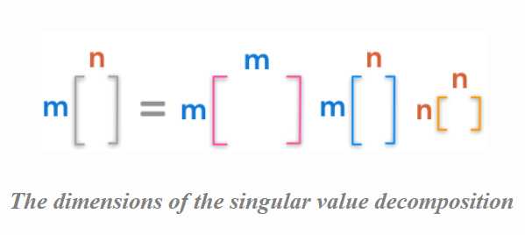
Singular Value Decomposition(SVD)
The singular value decomposition (SVD) of a matrix is a central matrix decomposition method in linear algebra. The eigendecomposition can be done only for square matrices. The way to go to decompose other types of matrices that can’t be decomposed with eigendecomposition.
We will decompose A into 3 matrices:

Slide 4
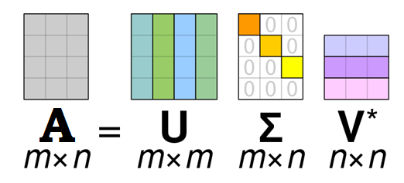
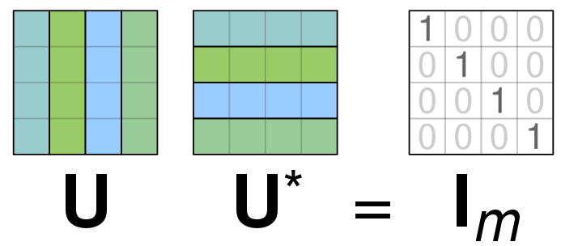
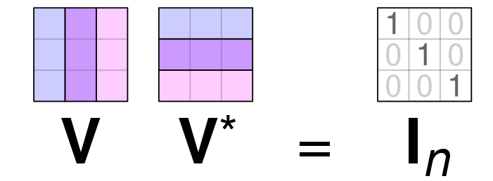
Singular Value Decomposition(SVD)
With following properties:

Slide 5
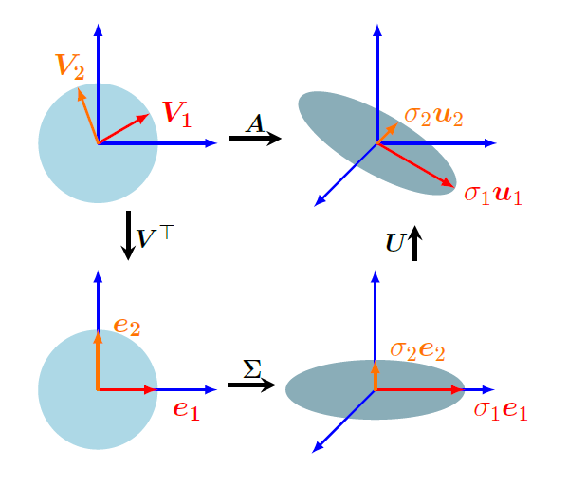
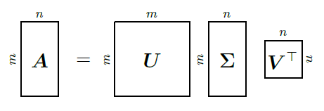
Singular Value Decomposition(SVD)
Every matrix can be seen as a linear transformation

Slide 6
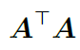
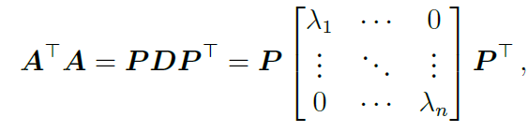
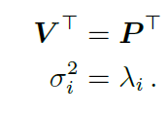
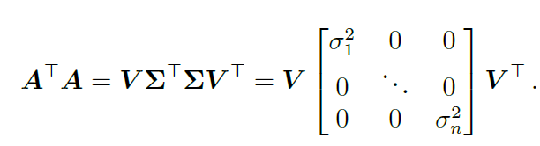
Singular Value Decomposition(SVD)
Construction of the SVD
Let us begin with constructing the right-singular vectors. The spectral theorem tells us that symmetric matrix possesses an ONB of eigenvectors(diagonalize) . Thus, we can always diagonalize and obtain:
Comparing

Slide 7
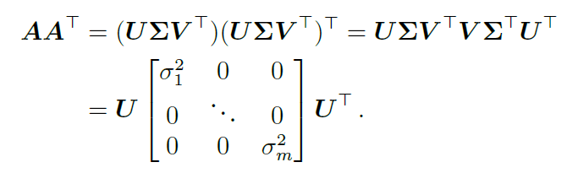
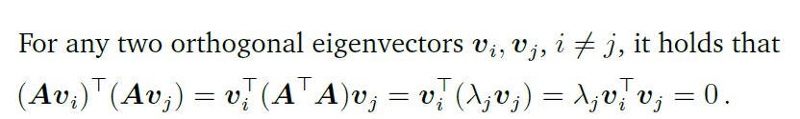
Singular Value Decomposition(SVD)
Similarly we calculate left singular vectors U of A

Slide 8
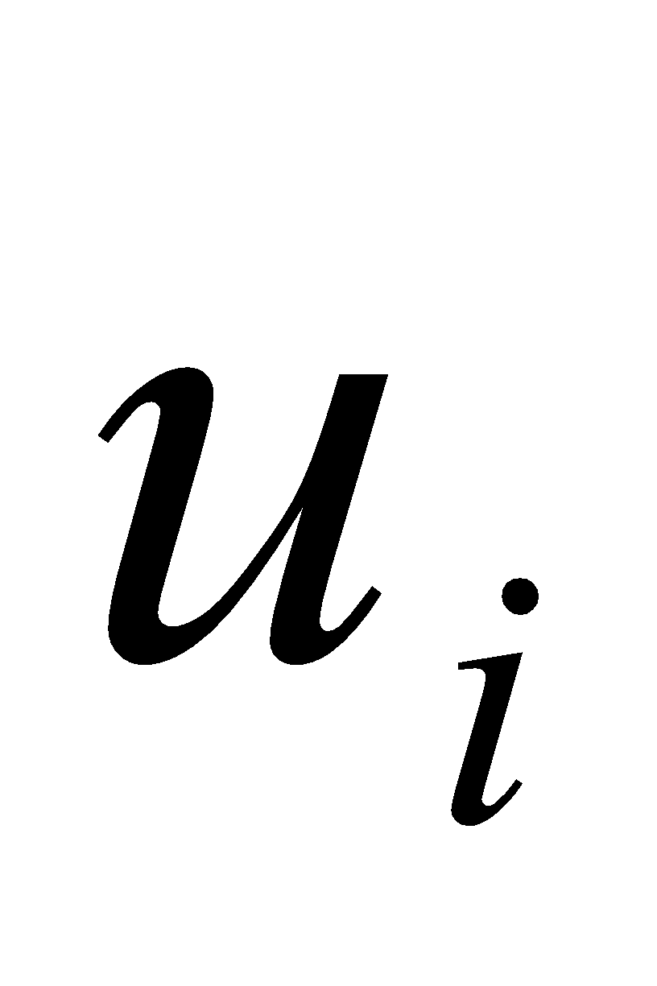
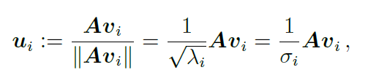
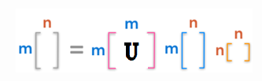
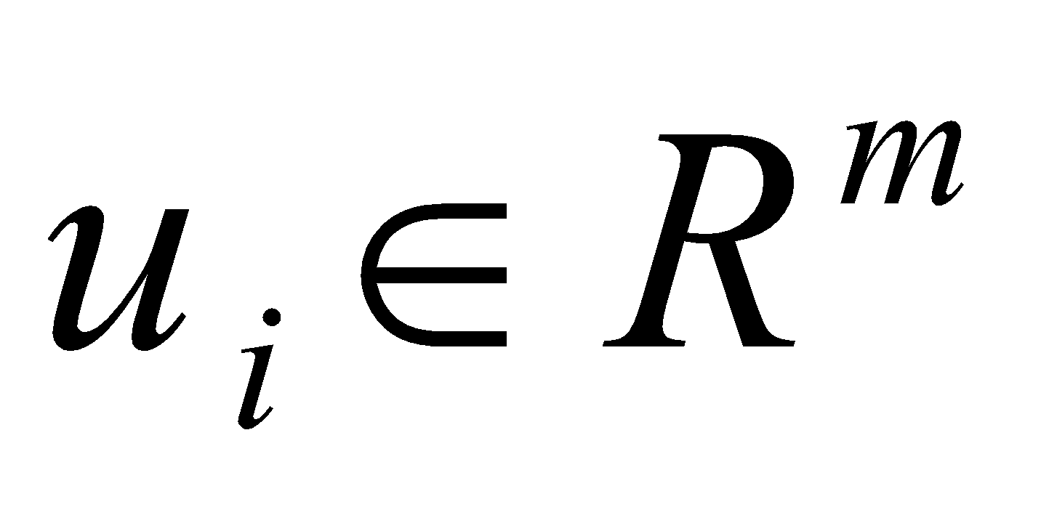
Singular Value Decomposition(SVD)
we calculate left singular vectors of U

Slide 9
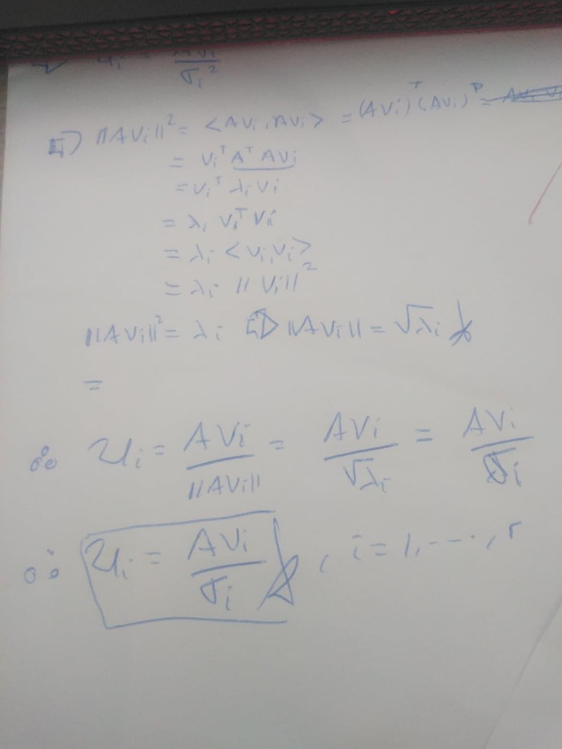
Singular Value Decomposition(SVD)

Slide 10
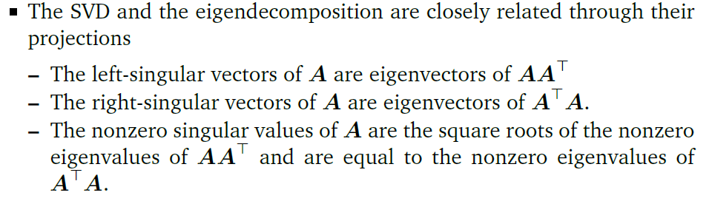
Singular Value Decomposition(SVD)

Slide 11
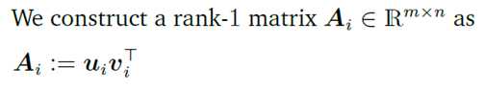
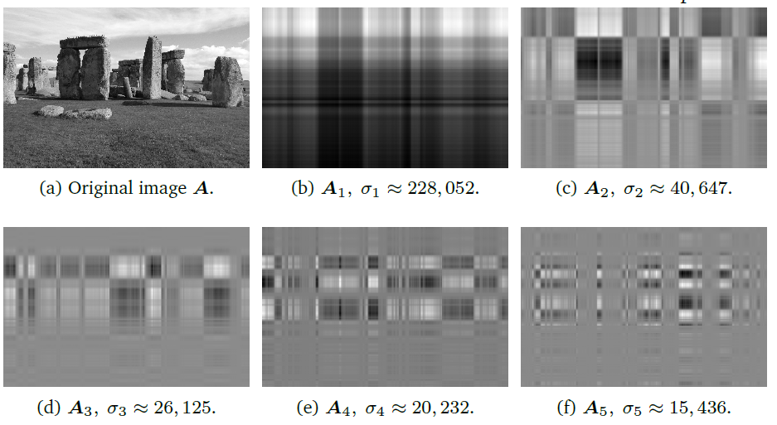
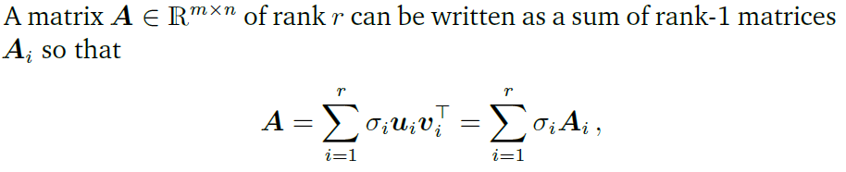
Singular Value Decomposition(SVD)

Slide 12
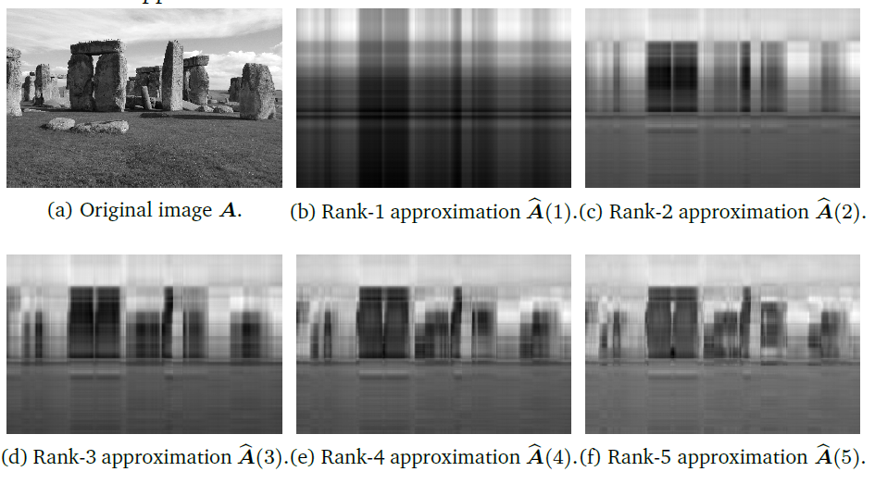
Singular Value Decomposition(SVD)
Apply the SVD on images

Slide 13
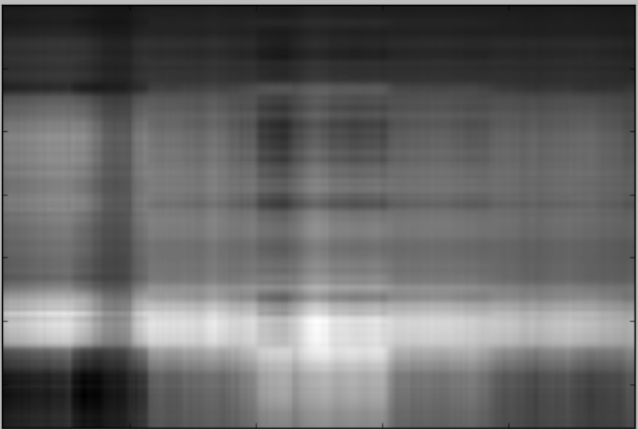
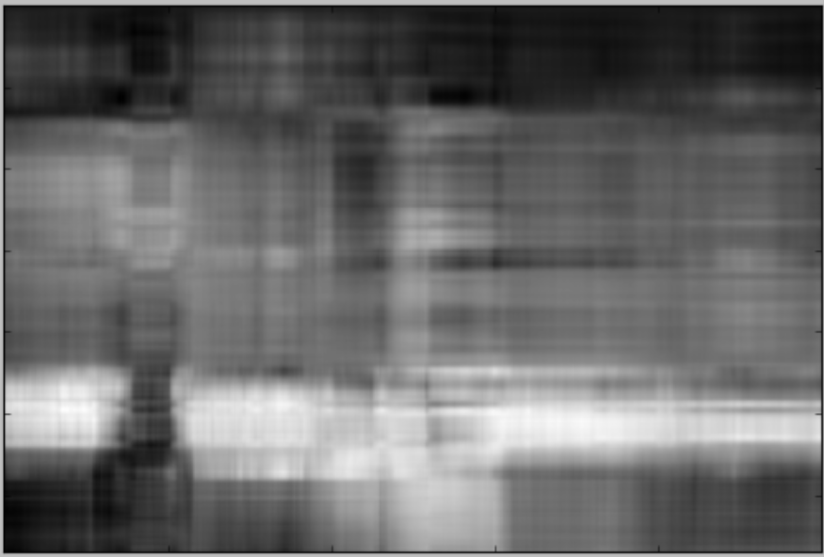
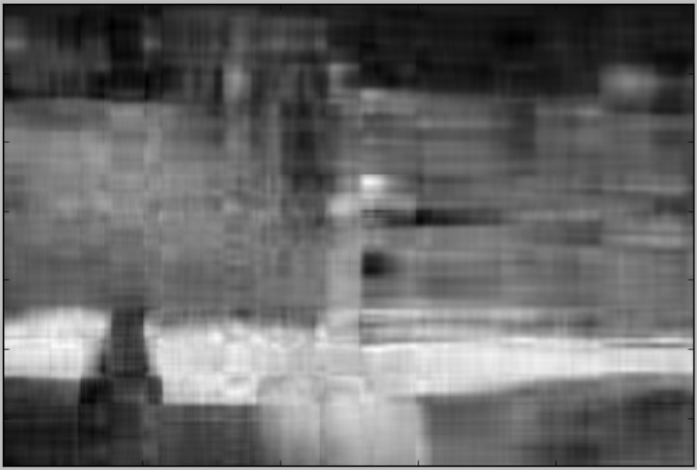
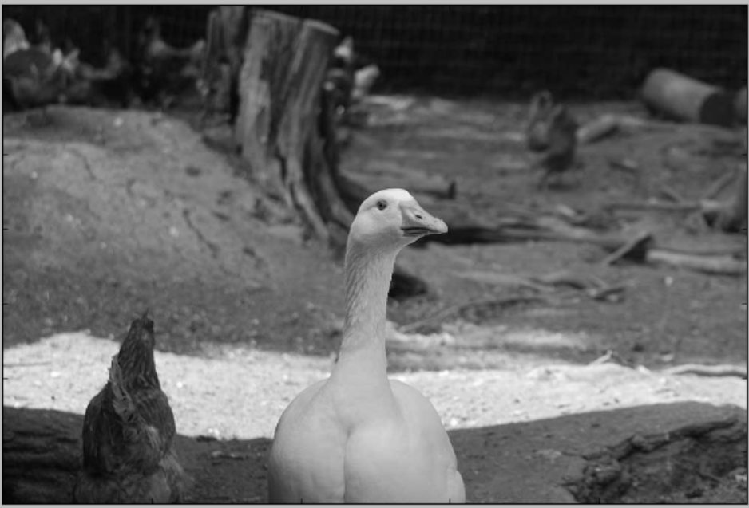
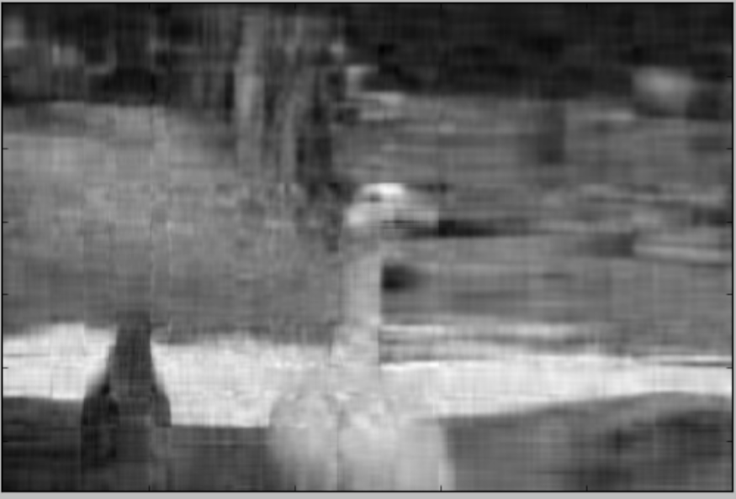

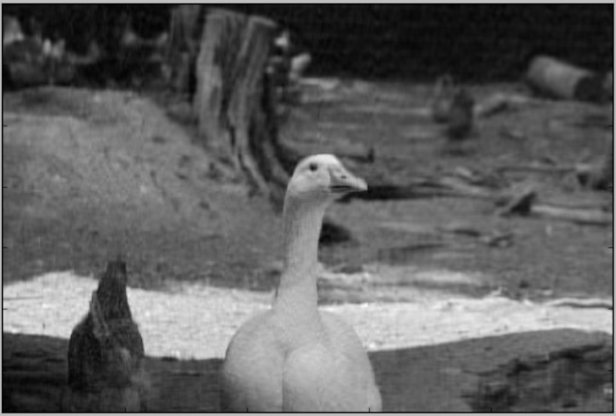
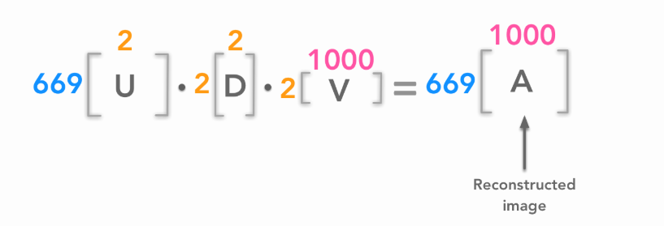
Singular Value Decomposition(SVD)
Apply the SVD on images
n=2
n=5
n=10
n=15
n=30
n=50

Slide 14
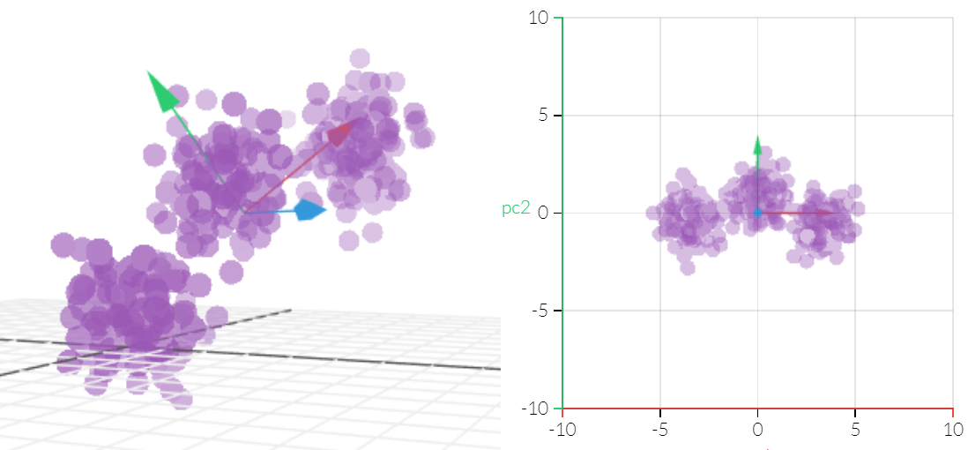
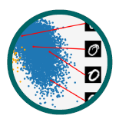
Principal Component Analisys(PCA)
An algorithm for linear dimensionality reduction. PCA, proposed by Pearson(1901) and Hotelling(1993) is still one of the most commonly used tecniques for data compression and data visualization. It is also used for the identification of simple patterns, latent factors, and structures of high-dimensional data

Slide 15
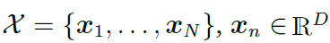
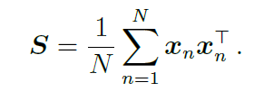
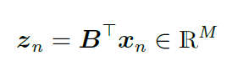
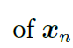
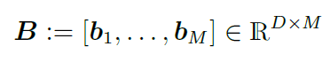
Principal Component Analisys(PCA)
In PCA, we seeks a projection that preserves as much information in the projected data as posible. More concretely, we consider an i.i.d. dataset
With mean 0 that possesses the data covariance matrix:
Furthermores, we asume there exists a low-dimensional compressed representation(code)

Slide 16
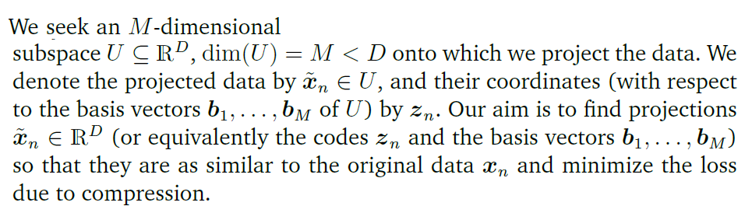
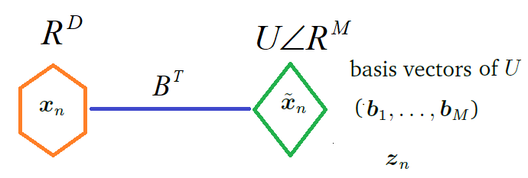
Principal Component Analisys(PCA)

Slide 17
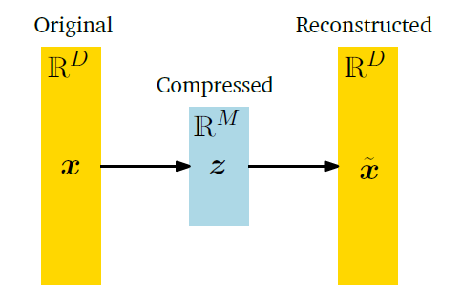
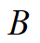
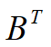
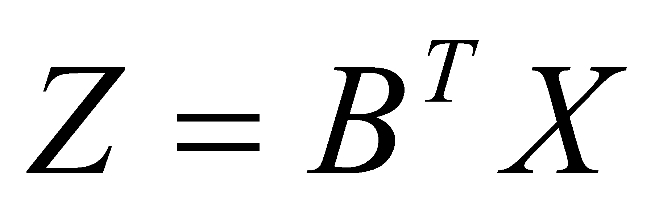
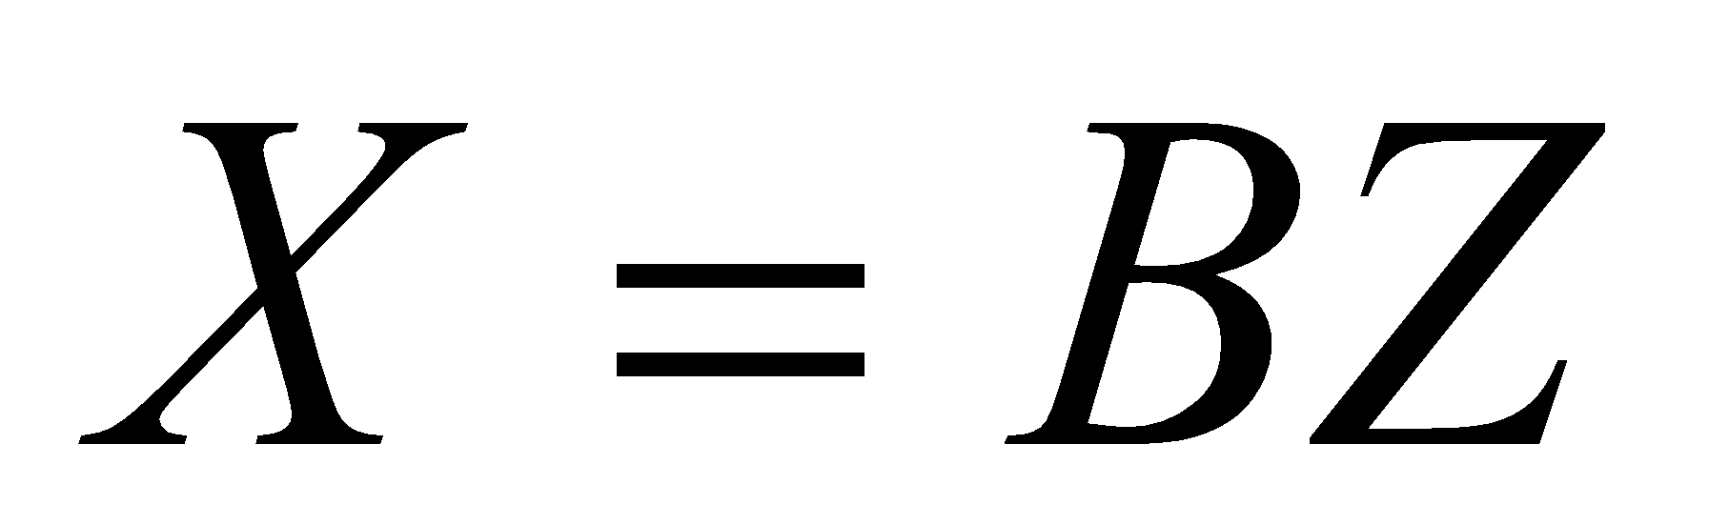
Principal Component Analisys(PCA)
Where:
Encoder
Decoder

Slide 18
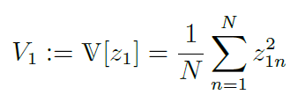
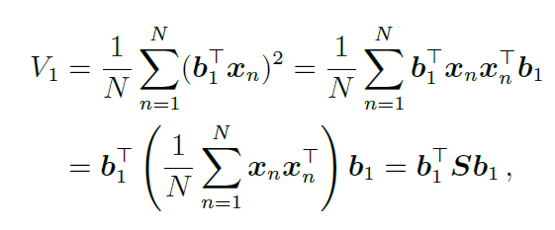
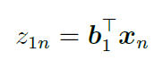
Principal Component Analisys(PCA)
Maximum Variance Perspective
Retaining most information after data compression is equivalent to capturing the largest amount of variance in the low-dimensional code (Hotelling, 1933).

Slide 19
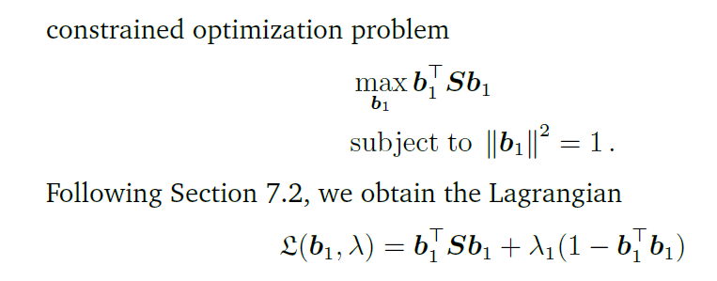
Principal Component Analisys(PCA)
Maximum Variance Perspective

Slide 20
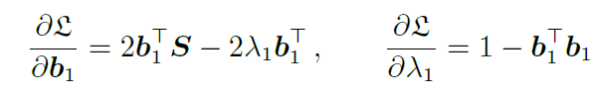




Principal Component Analisys(PCA)
Maximum Variance Perspective

Slide 21



Principal Component Analisys(PCA)
‹#›
Maximum Variance Perspective
Matrix form

Slide 22



Principal Component Analisys(PCA)
Maximum Variance Perspective
Assume we have found the first m-1 principal componente as the m-1 eigenvectors of S that are associated
with the largest m-1 eigenvalues.

Slide 23






Principal Component Analisys(PCA)
Geometric approach

Slide 24


Principal Component Analisys(PCA)
Eigenvector Computation and Low-Rank Approximations

Slide 25


Principal Component Analisys(PCA)
Applying PCA to Faces
The face images must be centered and of be same size
PCA

Slide 26


Principal Component Analisys(PCA)
Principal Analysis Component(PCA), a estándar tool for feature selection and dimensionality reduction, can be strongly affected by outliers.
Classical PCA fails even with a few outliers

Slide 27
Principal Component Analisys(PCA)
Limitations
Background changes
Light changes degrade performance
Performance decreases quickly with changes to face size
Performance decreases with changes to face orientation

Slide 28








Principal Component Analisys(PCA)

Slide 29



Robust Principal Component(RPCA)
In consequence of the limitations to the PCA, mainly of the outliers. This motivated the development of robust PCA methods which recover the PCs of the uncontaminated data.
The objective of the RPCA is to decompose the data into two matrices, one representing the uncontaminated data (L) and the other representing the outliers (S). :
The decomposition could be solved by the following convex optimization:
Where:
: Controls the amount of outliers in RPCA

Slide 30


Robust Principal Component(RPCA)
Robust Principal Analysis Component(RPCA)

Slide 31

Learning Linear Transformations for Fast Arbitrary Style Transfer
A style transfer method takes a content and a style image as inputs to synthesize an image with the look from the former and feel from the latter

Slide 32

Style Transfer by Linear Transformation

Slide 33




. Objectives for Arbitrary Style Transfer
The objective of learning the style transformation is equivalent to minimizing the difference of centered covariance between

Slide 34



Model for learning transformation
Affinity preserving for linear transformation models

Slide 35


Loss module
The final loss is a weighted sum of content loss ans style loss:

Slide 36
Reference
MATHREMATICAS FOR MACHINE LEARNING. Marc P. Deisenroth.
https://hadrienj.github.io/posts/Deep-Learning-Book-Series-2.8-Singular-Value-Decomposition/
Generalized Principal Component. Renè Vidal, Yi Ma
2012. Robust and practical face recognition via structured sparsity. In: Computer Vision–ECCV 2012. Springer, pp.
Bishop, C.M., 2006. Pattern Recognition and Machine Learning. Springer.
Bayesian robust principal component analysis with structured sparse component. Ningning Han

